Slide 1
Data Modeling
C393: Database Systems

Slide 2
Lesson Objectives
Create a conceptual data model by applying database design techniques

Slide 3
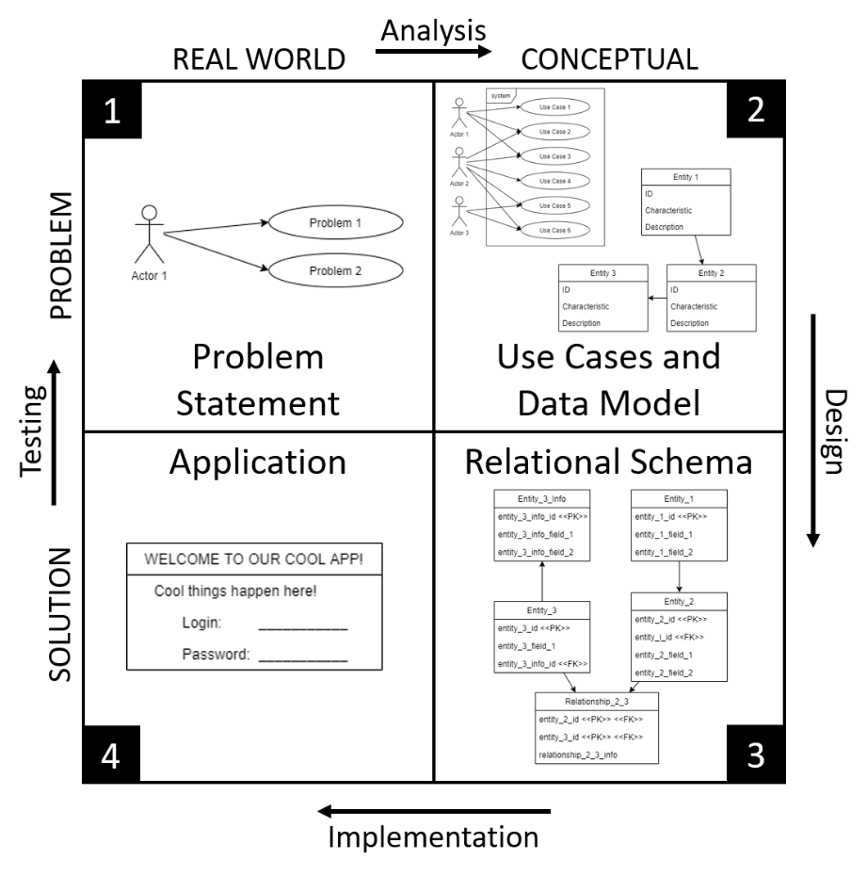
Iterative Design Process
Real World Problem
Problem Statement
Abstract Problem
Use Cases
Data Model
Conceptual Solution
Relational Schema
Interface Design
Implemented Solution
Database
User Interface
Adapted from Zelkowitz et al. 1979
Notes:
What is the point of CS393?
- Teach you to think (like a scientist/engineer)
- Iterative design process
Why do we need a design process? – where else have you used a process?
- It works (tested way to cover all the usual issues)
- Do it right or do it twice / measure twice, cut once / if you don't have time to do it right, when will you have time to do it over?
- Builds documentation for future work
How does this match other design processes you've worked with?
- Situation -> Analysis -> Solution Design -> Solution Implementation -> Test
First we want to understand what is the problem we are trying to solve; we may have a customer we are working with
Objective – what is the goal of this system we are trying to build?
Situation – what does this thing need to do? What are we trying to model?
Use Cases – who are the actors using this system and what do they need the system to do?
Data Model – abstract model of the entities and relationships described in the problem statement
Relational Schema – we take the data model and refine it define a relational database: data types, referential integrity, required/optional attributes
Application: schema implemented using a database management system and then incorporated into a LAMP server
Today we will focus on the Problem Statement
Note that the length of the arrows on the diagram has *nothing* to do with relative weight of each step (analysis, design, implementation, and testing).
They're just however long they fit.

Slide 4
Data Modeling

Slide 5
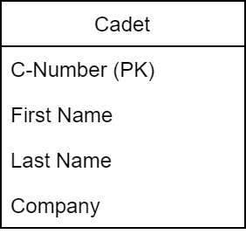
Class Diagrams
Unified Modeling Language (UML)
Top box: Type of Class
Bottom Box: Fields
Notes:
We will use something called Unified Modeling Language to describe databases
In UML we use class diagrams
Cadet is a class; can think of it as the type of entity we just looked at.
The bottom box are the fields of the Class; each entity or object has one of each of these fields.
In the Data Model we will specify which attribute is the primary key using (PK)

Slide 6
Modeling
Translate customer discussions into classes
Translate classes into design diagrams
Confirm diagrams with the customer
Work through “transactions” of data (data flows) with customer

Slide 7
Modeling Criteria
Structural validity
Simplicity
Expressibility
Nonredundancy
Shareability
Integrity
Diagrammatic Representation
Notes:
Structural validity – consistency with the way the enterprise defines and organizes information
Simplicity – ease of understanding
Expressibility – distinguish between different data, relationships between data, constraints
Nonredundancy – Exclusion of extra information, information represented only once
Shareability – not specific to a particular technology
Extensibility – able to extend and adapt
Integrity – consistent with the way the enterprise uses information
Diagrammatic representation – can use an easily understood model to represent

Slide 8
Conceptual Modeling
Identify Entity Types
Identify Relationships
Identify attributes
Determine domains
Determine keys
Check redundancy
Validate
Review

Slide 9
Entities
The types of things we need to store information about
Comes from our Problem Statement, Situation, and Use Cases.

Slide 10
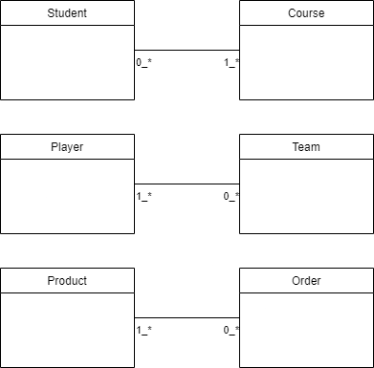
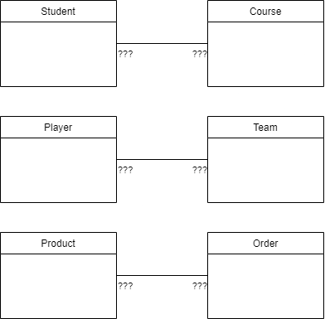
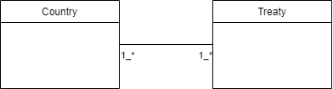
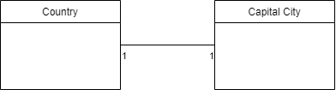
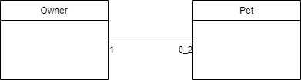
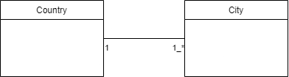
Relationship Questions
Typical Cardinality
One-to-One
One-to-Many
Many-to-Many
Cardinality between 1 and Many:
Could it be 2?
Optionality: 0 or 1?
Many-to-many: missing information?
Historical data?
Notes:
Cardinality expresses the number of entities to which another entity can be related. Typical cardinalities expressions are:
One-to-one: A entity associated with B entity at most once and vice versa
Country-Capital City; Person-Fingerprint
One-to-many: A entity associated with any number of B entity, B entity associated with A entity at most once
Many-to-one: A entity associated with B entity at most once; B entity associated with any number of A entity
Country-City; Owner-Pet
Many-to-many: A entity associated with any number of B entity and vice versa
Student-Course
We record the cardinality on the diagram
Cardinality between 1 and Many
Could it be 2 instead of 1 or infinity
On post a family/person can have at most 2 pets, but are not required to have pets
A pet can only have one owner, and by definition must have an owner (otherwise feral and not a pet)
Optionality:
At most as opposed to at least (although at least can be required in data model)
Student-Course relationship:
Must a student be enrolled in at least one course?
Are you a student if you are not enrolled in at least one course?
Must a course have at least one student enrolled?
Is it a class without at least one student enrolled?
Many-to-many
What information may be missing when discussing how Products are related to Orders?
What quantity?
At what price?
Discounts?
Player-Team relationship: Does a player play for only one team?
Maybe a year at a time, but what happens when the year is over?
What about historical data?
If a player changes teams, do we lose all statistical data for that player with that team?
Do we track salary? Where?
Need something between Student and Course / Player and Team / Product and Order to capture this additional information
Association Classes

Slide 11
Attributes
For each entity, which attributes do we need?
For each attribute or group of attributes, can we define a domain?

Slide 12
Keys
Identify candidate keys
Choose a primary key
Minimal set of attributes
Least likely to change
Smallest key
Easiest to use
Remainder are alternate keys
(FKs come later)

Slide 13
Check Redundancy
Examine 1:1 relationships
Remove redundant relationships
Consider time

Slide 14
Validate & Review
Validate any “transactions” from the use case analysis.
Check all info is provided by model
Diagram the transaction pathway (useful for creating views)
Review model with user

Slide 15
Your Turn
Identify Entity Types
Identify Relationships
Identify attributes
Determine domains
Determine keys
Check redundancy
Validate
Review

Slide 16
(Bad) Examples

Slide 17
Student Management System
Tables:
Students (Name, BirthDate)
Courses (CourseID, CourseName)
Enrollments (StudentName, CourseName, Grade)
Structural validity
Simplicity
Expressibility
Nonredundancy
Shareability
Integrity
Diagrammatic Representation

Slide 18
E-commerce
Tables:
Customers (CustomerID, Name, Address, PhoneNumber)
Orders (OrderID, OrderDate, OrderTotal, CustomerID, CustomerName, CustomerPhone)
Structural validity
Simplicity
Expressibility
Nonredundancy
Shareability
Integrity
Diagrammatic Representation

Slide 19
Library Management
Tables:
Books (BookID, Title, AuthorName, PublishedYear)
Borrowers (BorrowerID, Name, BookID)
Structural validity
Simplicity
Expressibility
Nonredundancy
Shareability
Integrity
Diagrammatic Representation

Slide 20
Human Resources
Tables:
Employees (EmployeeID, Name, DepartmentID)
Departments (DepartmentID, DepartmentName)
DepartmentEmployees (EmployeeID, DepartmentName)
Structural validity
Simplicity
Expressibility
Nonredundancy
Shareability
Integrity
Diagrammatic Representation

Slide 21
Course Management System
Tables:
Students (StudentID, Name)
Courses (CourseID, CourseName)
Structural validity
Simplicity
Expressibility
Nonredundancy
Shareability
Integrity
Diagrammatic Representation

Slide 22
Use Case -> Data Model
Take the use cases you built from the previous lesson
Create a data model from those use cases.
Entity types
Relationship types
Attributes
Keys
Integrity constraints
Structural validity
Simplicity
Expressibility
Nonredundancy
Shareability
Integrity
Diagrammatic Representation

Slide 23
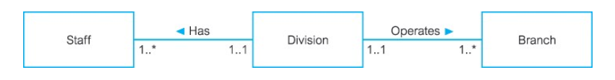
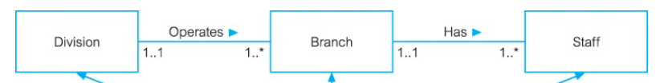
Fan Traps
Two one:many relationships extending from the same entity
Impossible to answer certain questions
ID | name | division |  | ID | division |  | ID | address | division
1 | John | A |  | A | R&D |  | 1 | Maple | A
 |  |  |  |  |  |  | 2 | Oak | A
Which criteria does the fan trap fail?

Slide 24

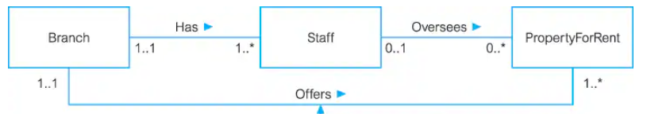
Chasm Traps
Which criteria does the chasm trap fail?
One or more relationships with optional participation
Impossible to answer certain questions
ID | address |  | ID | name | branch |  | ID | location | manager
A | Maple |  | 1 | John | A |  | EE | Hartford | 1
B | Oak |  |  |  |  |  | FF | Sioux Falls

Slide 25
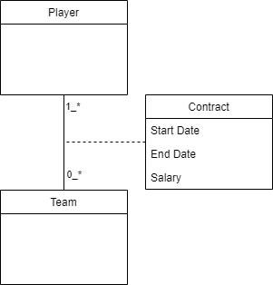
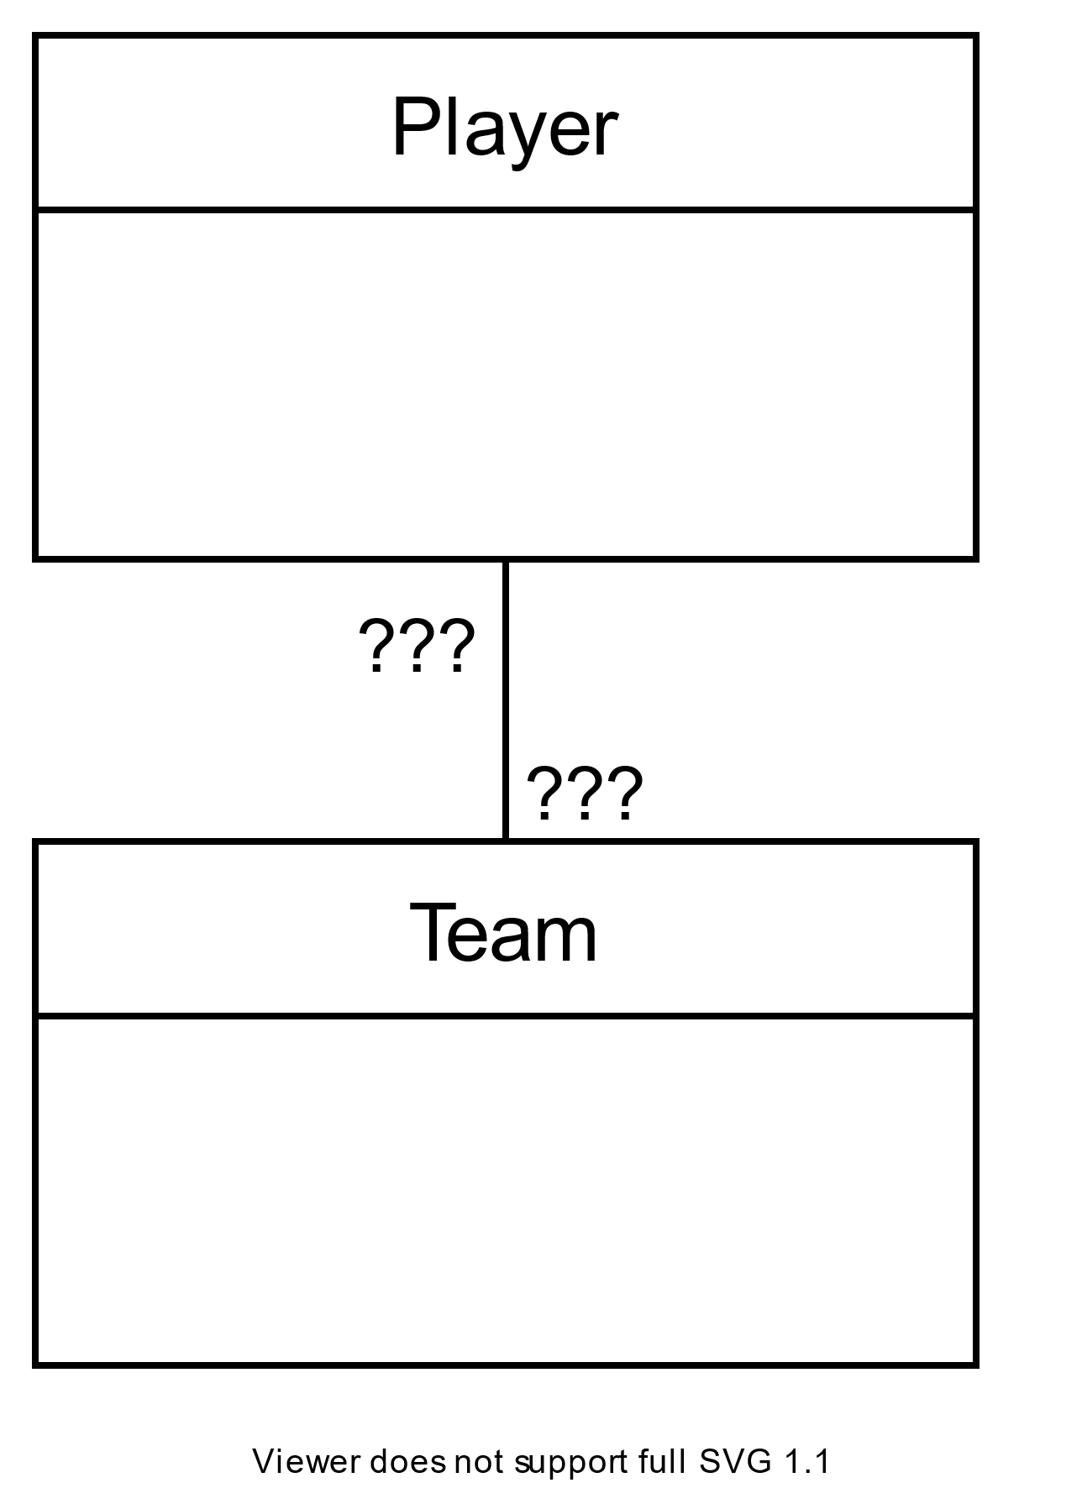
Players and Teams
LeBron James
Cavs, 2003-2010
Heat, 2010-2014
Cavs, 2014-2018
Lakers, 2018-2022
How do we store this data?
Association classes handle this problem.
Notes:
Let’s say our model is that a player can play with exactly one team
We could store the salary and start/end dates with the player, but this data will be overwritten when the player changes teams
Can solve this with Association Classes
Create an Association Class between Player and Team called Contract
Contract holds the information Salary, Start date, and End date
There are some constraints we can worry about later
A player can have many Contracts, but …
A player should only have one active contract
----------------------------------------------
(
How many teams can a player contract with at once?!
We need a [trigger](https://dev.mysql.com/doc/refman/8.0/en/triggers.html).
)
What would the SQL look like now to find all players *currently* on a team?
```sql
SELECT * FROM player NATURAL JOIN contract NATURAL JOIN team
WHERE CURDATE() BETWEEN startDate AND endDate;

Slide 26
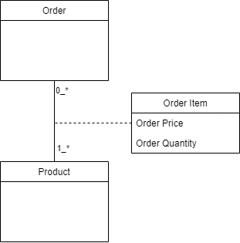
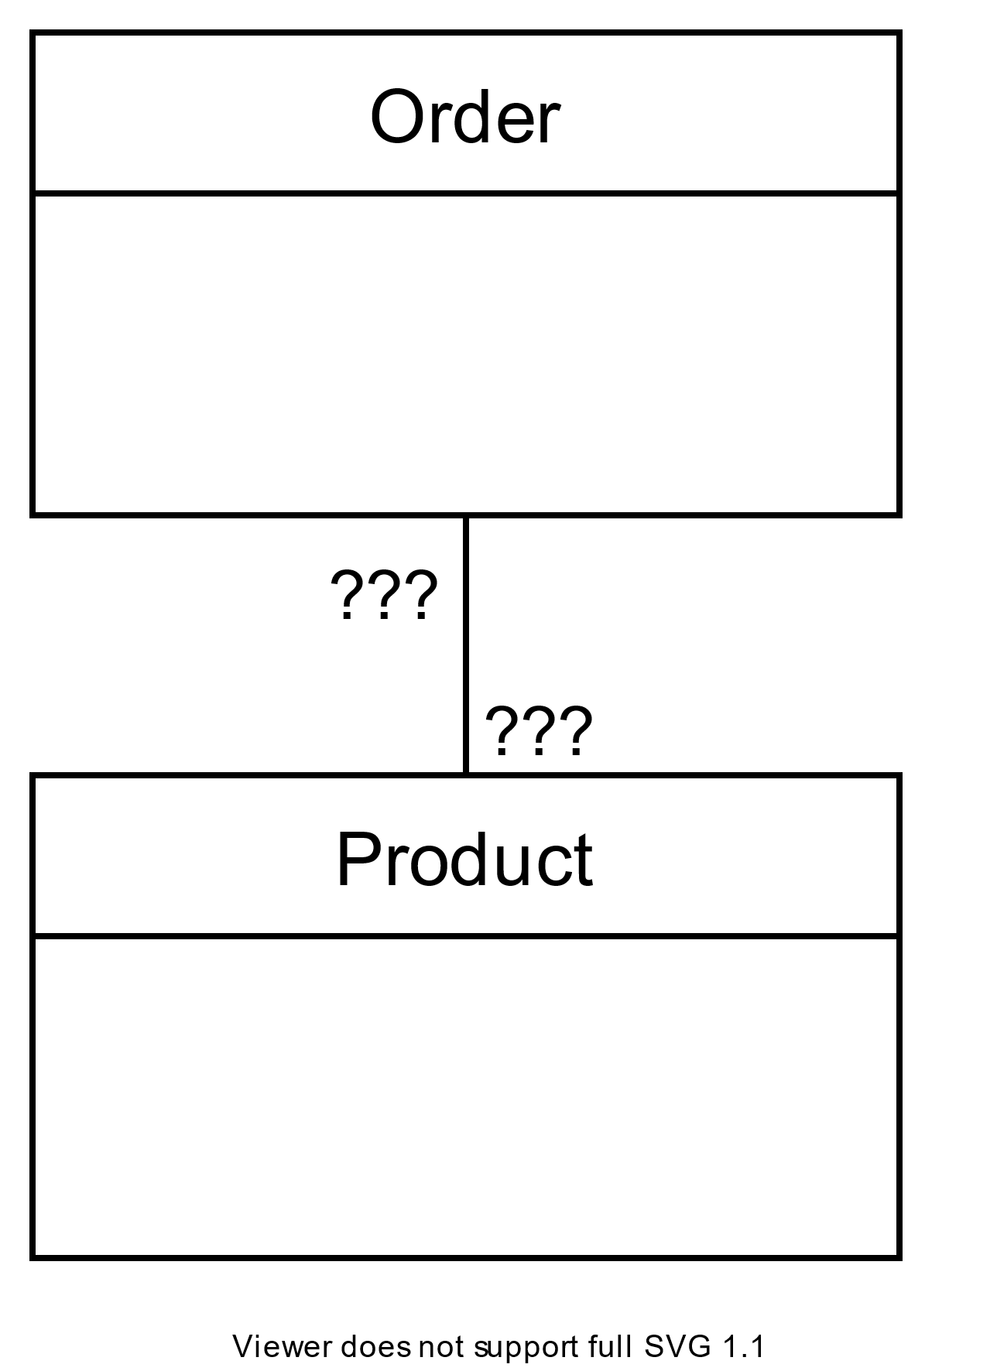
Products and Orders
Order 20005
10 × ANV01
3 × ANV02
5 × TNT2
1 × FB
1 x FB @ half price
How do we store this data?
Notes:
How can we store the information about how much of a product was in an order?
What if a product appears in an order twice at two different prices?
Association Classes can also help us store information about the relationship between Products and Orders

